Slide 1

eBay Text Classification and Topic Modeling
University of San Diego
Leonard Littleton, Kiran Singh, Andrew Zazueta

Slide 2

Problem Statement
Web Scrape eBay reviews to build classification models and topic models
Ability to predict whether a customer would leave a positive review (4-5 stars) or negative review (1-3 stars) based off the information in the title of their review
Determine which product the customer was referring to by building a topic model with 5 distinct topics (1 topic for each eBay product scraped)
Classification Models:
Linear SVC
Logistic Regression
KNN
Naive Bayes
Random Forest
SVM
Topic Models:
LSA
LDA
NMF
Figure 1. eBay (1999). [eBay Logo]. Retrieved from https://commons.wikimedia.org/wiki/File:EBay_former_logo.svg

Slide 3
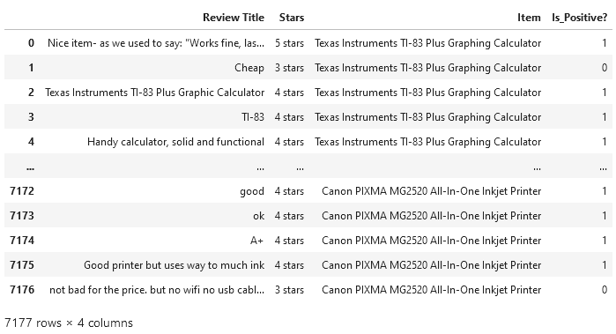
Data Description
Products chosen for text analysis:
TI-83 Plus Graphing Calculator
AirPods
PlayStation 5
LED Tactical Flashlight
Inkjet Printer
BeautifulSoup used for scraping html from eBay
Information pulled:
Review Title
Review Contents
Star Rating
Figure 2. Final Data Frame.

Slide 4
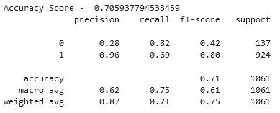
Linear SVC
Linear Support Vector Classifier
Creates hyperplane that divides data for predictive analysis
Hyperparameters modified
Tolerance (10^-5)
Results (Baseline Accuracy- 87.1%)
Figure 3. Linear SVC model statistics.

Slide 5
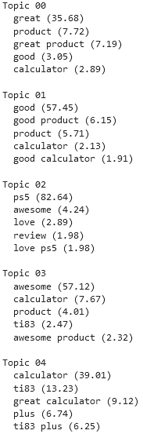
LSA Topic Model
Latent Semantic Analysis
Converts text into matrices
Word-topic
Document-topic
Finds the most optimal matrices to divide topics
Hyperparameters modified
Number of components (5)
Results:
Only two distinct topics (products) were found
PS5 (02)
TI-83 (00, 01, 03, 04)
FIgure 4. Model groupings for LSA.

Slide 6
Thank you!
Any questions can be directed to the following emails:
leonardlittleton@sandiego.edu
ksingh@sandiego.edu
azazueta@sandiego.edu

Slide 7
References
eBay (1999). [eBay Logo]. Retrieved from https://commons.wikimedia.org/wiki/File:EBay_former_logo.svg

